Slide 1
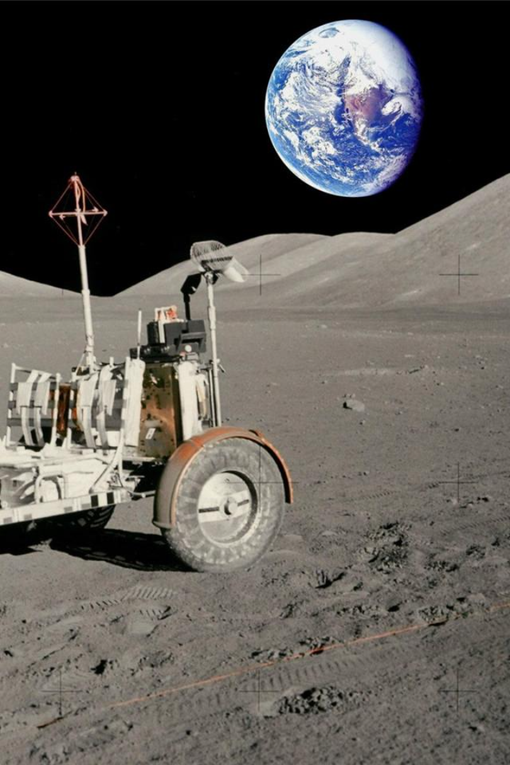
Lunar Hazard Planning
Lunar navigation is a fascinating and complex task that requires advanced technology and precise mapping for safe and accurate landings on the moon. Let's explore the key elements involved in this exciting process!
Rahul Kumar Singh
Vipin Sharma
Hamesh Kumar Puniya
Sushant Matnani
Rishit Srivastava
Anjali

Slide 2

Hazard Maps
Super-Resolution Techniques
Utilizing Super-Resolution
Mapping the Moon's Hazards
To overcome the challenge of working with lower resolution data, we employ super-resolution techniques. These methods enhance the quality of lunar images, making them suitable for further analysis and navigation.
The super-resolution techniques we use involve advanced deep learning models, particularly the powerful Keras framework. By leveraging generative adversarial networks (GANs), we can improve image resolution and sharpness.
Creating hazard maps is the first step in safely navigating a lunar lander. These detailed maps help us identify potential risks and plan our landing strategy effectively.

Slide 3
Crater Detection
Enhancing Accuracy with OpenCV
1
Identifying Lunar Hazards
2
Elliptical Object Retrieval
3
Crater detection is essential for terrain relative navigation and hazard avoidance during lunar landings. We employ sophisticated computer vision models to identify and analyze craters in high-resolution lunar images.
Our crater detection model utilizes the Ellipse R-CNN, a powerful model that combines Mask R-CNN for elliptical object retrieval and U-Net Semantic Segmentation for learning occlusion patterns within crater images.
To ensure accurate crater identification, we leverage pre-trained computer vision models from OpenCV. These models assist us in precisely detecting and analyzing craters on the lunar surface.

Slide 4

Crater Matching
1
Identifying Crater Patterns
Once craters are detected, we focus on identifying patterns within these unique lunar features. This aids in faster and more accurate recognition of craters, enhancing the navigation process and improving hazard assessment.
2
Advanced Pattern Recognition
We employ advanced pattern recognition algorithms that analyze the shape, size, and distribution of craters on the moon's surface. This enables us to identify and match craters with precision.
3
Improving Navigation Efficiency
By identifying and matching crater patterns, we can optimize the navigation process. This allows for more efficient and safer lunar landings, reducing the risks associated with unfamiliar lunar terrains.

Slide 5
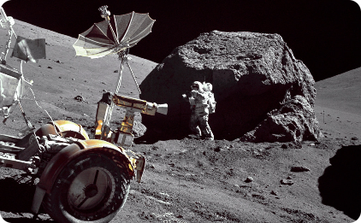
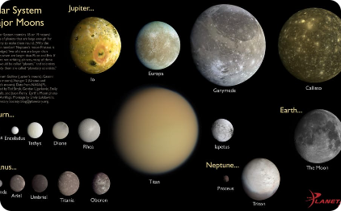
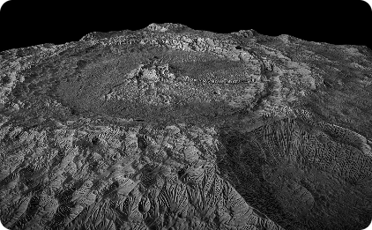
Visual Terrain Relative Navigation
Depth Estimation for Safety
Terrain Classification
Identifying Lunar Surface Features
Depth estimation is crucial for visual terrain relative navigation. We employ advanced machine learning techniques, such as Pix2Pix and GANs, to determine the depth of the moon's surface relative to the camera's position, enhancing safety and precision.
In addition to crater detection, we identify other critical lunar surface features such as boulders, rifts, and slopes. This information helps with route planning and obstacle avoidance.
To classify different types of lunar terrains, we utilize DenseNet, a state-of-the-art convolutional neural network architecture. This segmentation technique helps us plan routes and avoid potential obstacles.

Slide 6

Challenges and Dependencies
Fine-Tuning for Optimal Results
1
While our approach shows promise, feature-based transformations like super-resolution require tuning and balancing to achieve optimal results. Continual refinement and improvement are necessary to enhance the quality of lunar navigation.
2
Dealing with Lunar Lighting Conditions
Lunar lighting conditions pose challenges for image analysis. Areas of permanent shadow and intense sunlight require adaptive algorithms to ensure accurate detection of lunar features.
3
Continual Research and Updates
The dynamic lunar environment requires regular updates to our navigation system. As we learn more about the moon and its terrains, we continuously refine our methods and models to ensure the safety and success of lunar missions.

Slide 7
Cutting-Edge Technology for Lunar Navigation
Deep Learning Models (Keras)
Ellipse RCNN
Ellipse R-CNN is a specialized technology stack for object detection. It is commonly employed in applications such as crater detection. Leveraging Region-based Convolutional Neural Networks (R-CNN) principles, Ellipse R-CNN excels in accurately locating and classifying elliptical objects, making it a valuable tool for tasks requiring precise shape recognition, such as identifying craters in satellite imagery.
Our lunar navigation system heavily relies on deep learning models to process and analyze lunar images. These models enable us to accurately detect and classify various lunar features.
Fine-Tuned Generative Models (GANs)
OpenCV
OpenCV is a versatile computer vision library widely used for image and video processing. It provides a seamless interface for utilizing pre-trained models, facilitating tasks such as object detection, face recognition, and image classification.
We employ fine-tuned generative models, such as generative adversarial networks (GANs), to enhance the resolution, sharpness of lunar images. These models help us extract valuable information for navigation and analysis.

Slide 8
Cutting-Edge Technology for Lunar Navigation
DenseNet
Python
DenseNet, a convolutional neural network architecture, is adept at terrain classification tasks. Known for its dense connectivity pattern, where each layer receives direct input from all preceding layers, DenseNet promotes feature reuse, making it effective for capturing intricate patterns in terrain data.
It is the foundation for the given models.
Leveraging its densely connected structure, DenseNet enhances model performance in discerning diverse terrain types from satellite or aerial imagery, making it a robust choice for applications requiring accurate and detailed terrain classification.

Slide 9
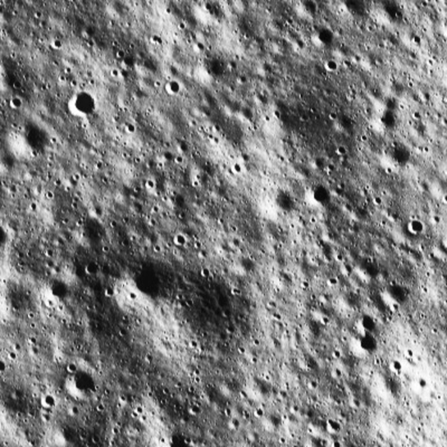
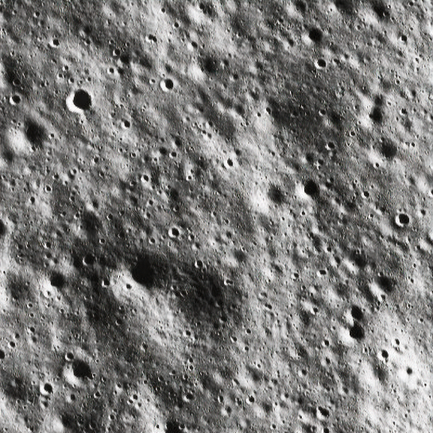
Result and analysis
Image Super Resolution
Input
Output

Slide 10
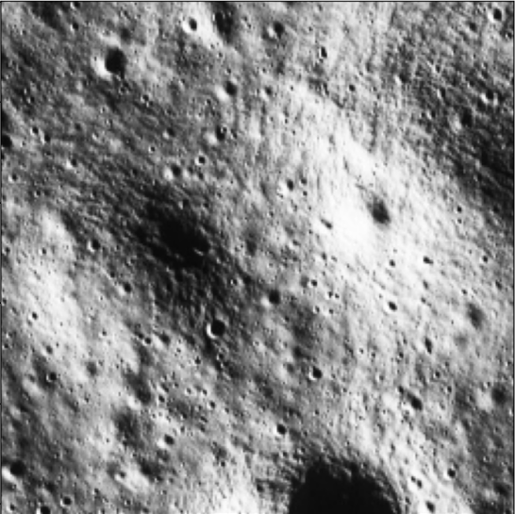
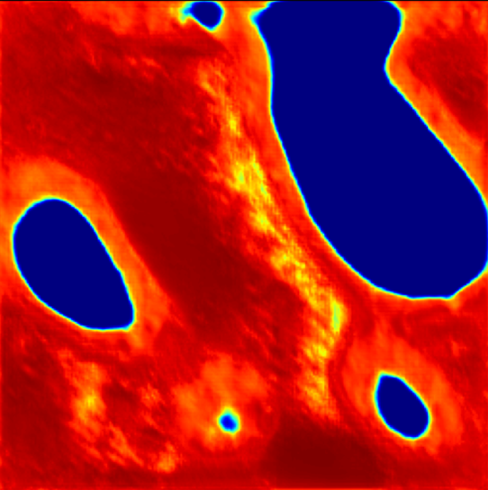
Result and analysis
Depth Resolution
Input
Output

Slide 11
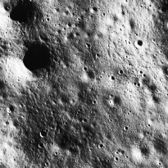
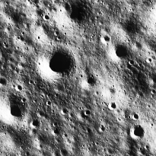
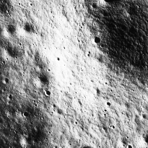
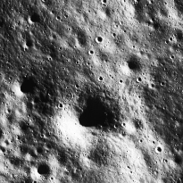
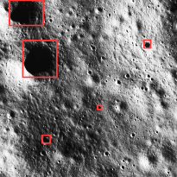
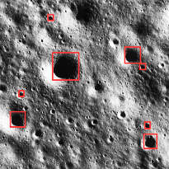
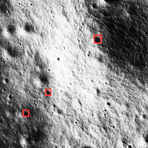
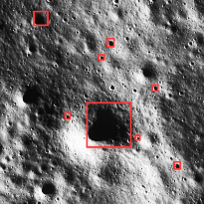
Result and analysis
Crater Detection
Input
Sample 1
Sample 2
Sample 3
Sample 4
Output
Result 1
Result 2
Result 3
Result 4

Slide 12
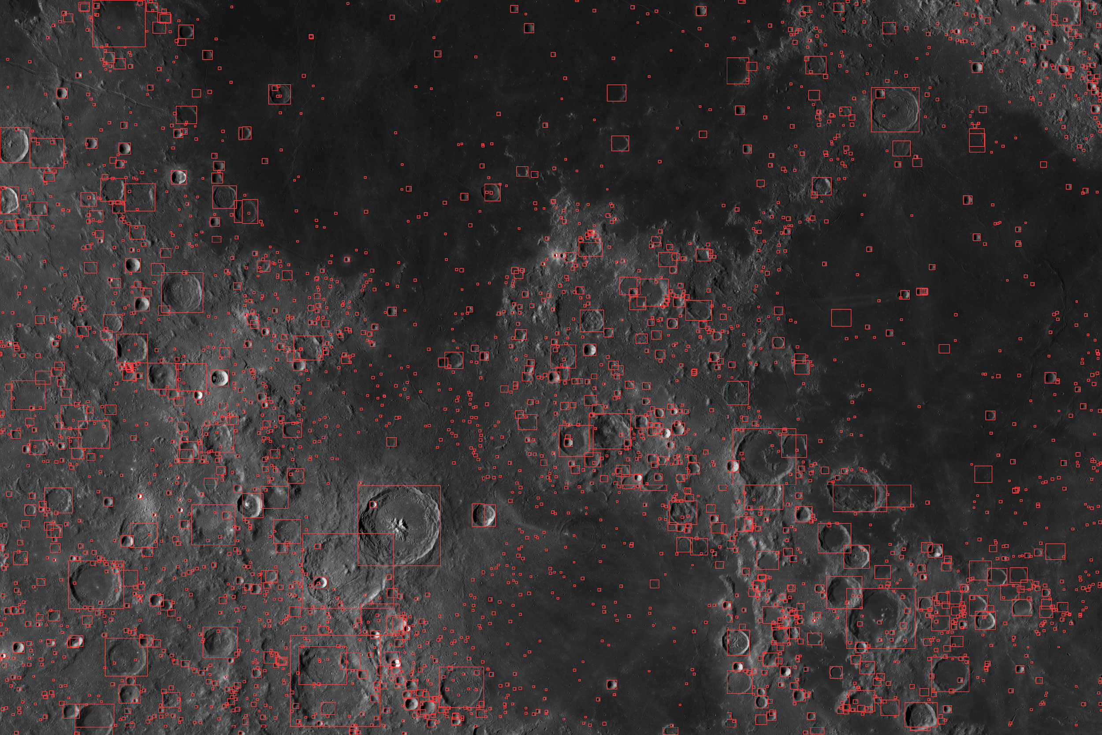
Overall Result after training the model with different samples

Slide 13
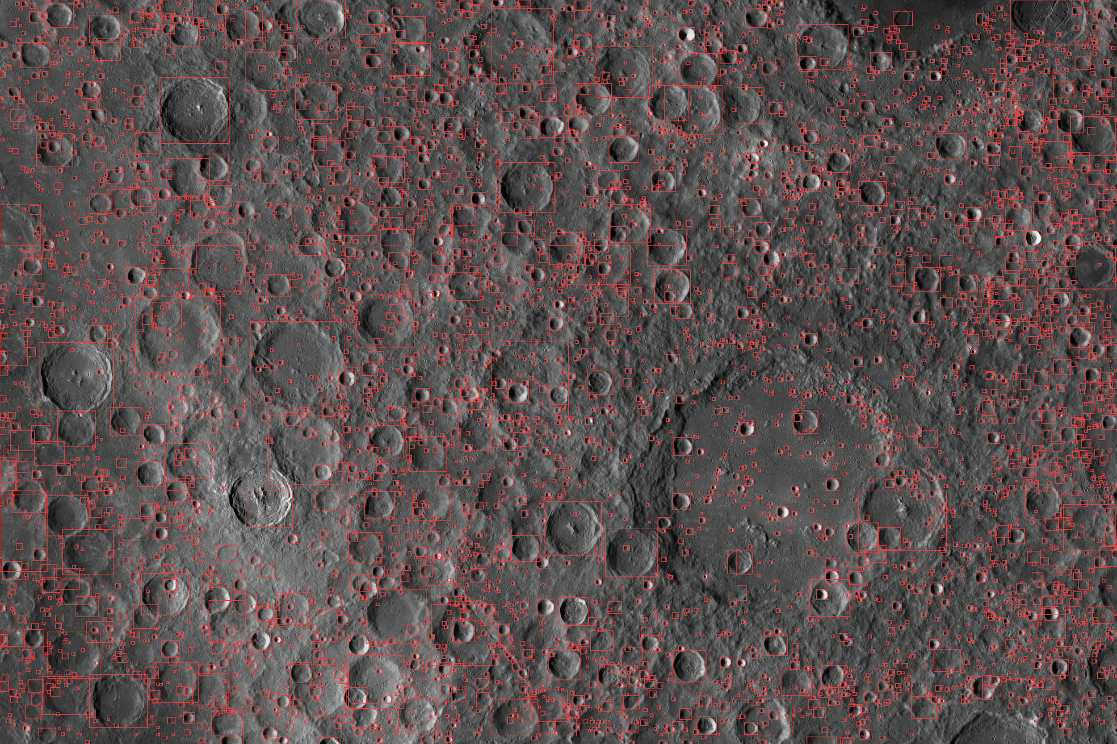
Overall Result after training the model with different samples

Slide 14
Advancing Lunar Exploration
2
Facilitating Scientific Endeavors
1
Safe and Precise Lunar Landings
Accurate lunar navigation opens up opportunities for scientific research and exploration. By enabling reliable and efficient navigation, we empower scientists to conduct experiments and collect valuable data.
By combining cutting-edge technology and innovative methods, our lunar navigation system ensures safe and precise landings on the moon's surface. This is crucial for future lunar exploration missions.

Slide 15
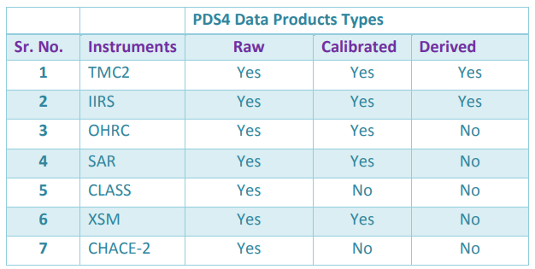
Chandrayaan-2 PDS4 Data Archive
PDS4 is the de facto international standard for long term archival of planetary science data. For all the scientific payloads, PDS4 data products types [1] were identified and shown in the below

Slide 16
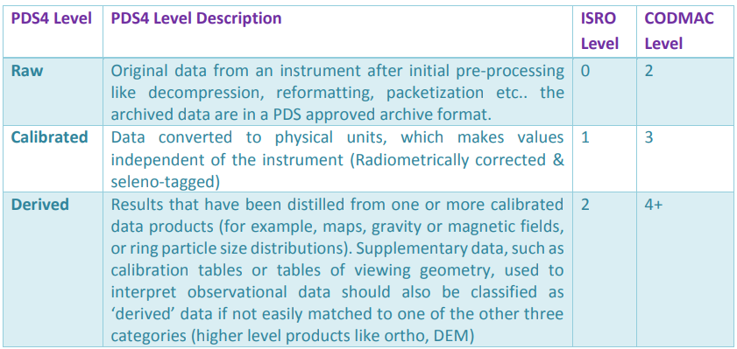
Chandrayaan-2 PDS4 Data Archive

Slide 17
yyyy
TMC2 PDS4 Data Products
The PDS4 Data Products for TMC2 is defined based on the defined data processing levels (L0, L1 and L2) as Raw, Calibrated and Derived data products.
Raw Data Products: Raw Data Products contains raw data without any correction along with the system level corner coordinates. For each payload observation, PDS4 data products are generated (based on product id & sensor id derived from file name, zipped and organized under year month day wise collection directory defined under instrument collection structure
For example, user has downloaded the zip product as:
• ch2_tmc_nrf_20191015T102125157610840_d_img_blr.zip
ch2_tmc_nra_20191015T102125154360840_d_img_blr.zip
ch2_tmc_nrn_20191015T102125154360840_d_img_blr.zip
Calibrated Data Products: Calibrated Data Products contains radiometrically corrected data along with the refined corner coordinates. For each payload observation, PDS4 data products are generated (based on product id derived from file name, zipped and organized under year month day wise collection directory defined under instrument collection structure.
For example, user has to download the zip product as:
ch2_tmc_ncf_20191015T102125157610840_d_img_blr.zip
ch2_tmc_nca_20191015T102125154360840_d_img_blr.zip
ch2_tmc_ncn_20191015T102125154360840_d_img_blr.zip

Slide 18
yyyy
TMC2 PDS4 Data Products
Derived Data Products:: Derived Data Products contains radiometrically and geometrically corrected data along with the corner coordinates. For each payload observation, PDS4 data products are generated (based on product id derived from file name,, zipped and organized under year month day wise collection directory defined under instrument collection structure
For example, user has downloaded the zip product as:
ch2_tmc_ndn_20191015T102125154360840_d_dtm_blr.zip
ch2_tmc_ndn_20191015T102125154360840_d_oth_blr.zip

Slide 19
yyyy
TMC2 PDS4 Archive Products
Data that comprises the TMC 2 archives are formatted in accordance with PDS specifications. This section provides details on the formats used for each of the products included in the archive
TMC 2 instrument is an imaging payload. The primary data collected from instrument is raw image. The TMC 2 imager has three sensors – Fore, Aft and Nadir. For each sensor both primary as well as secondary data sets are defined that contains data product levels, types and formats shown in the table:

Slide 20
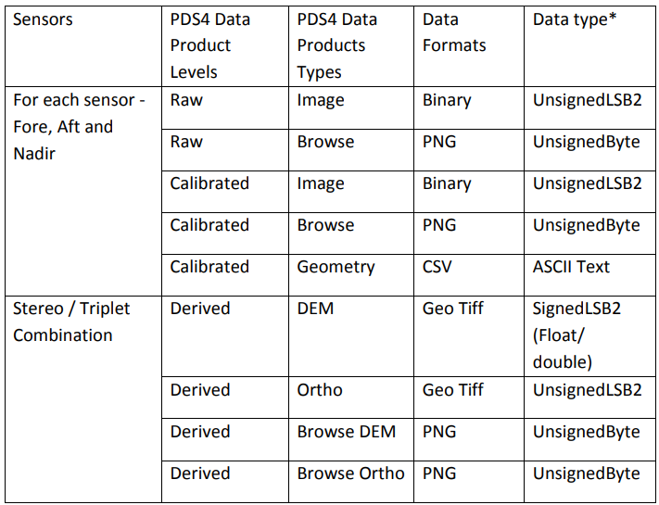
yyyy
TMC2 PDS4 Archive Products

Slide 21
yyyy
DTM
Digital Elevation Model (DEM), Digital Surface Model (DSM) and Digital Terrain Model (DTM) are three commonly implemented geospatial features generated with UAV mapping systems. Each data product delivers different elevation values as each model uses different methodologies. Elevation values from a LiDAR point cloud come from features including bare-ground, power lines, tree canopies or buildings.
A DTM (Digital Terrain Model) typically augments a DEM, by including vector features of the natural terrain, such as rivers and ridges. A DTM may be interpolated to generate a DEM, but not vice versa.
A DTM usually contains all the depth information of the map and is very useful for conveying the topography of a land sector.
A DTM is usually used in conjunction with a GIS (geographic information system) which can render the data in these images with various useful renders.

Slide 22
yyyy
QGIS
QGIS functions as geographic information system (GIS) software, allowing users to analyze and edit spatial information, in addition to composing and exporting graphical maps. QGIS software supports raster, vector and mesh layers. Vector data is stored as either point, line, or polygon features. Multiple formats of raster images are supported, and the software can georeference images.

Slide 23
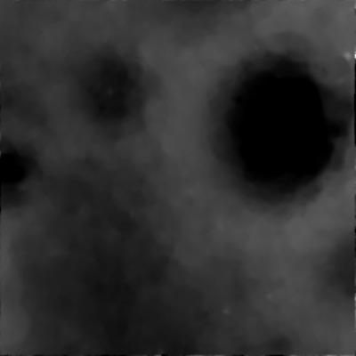
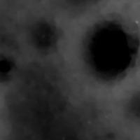
yyyy
Supersampling of Image
Fig: Original TMC sample
Fig: Super Sampled Image (TMC)

Slide 24
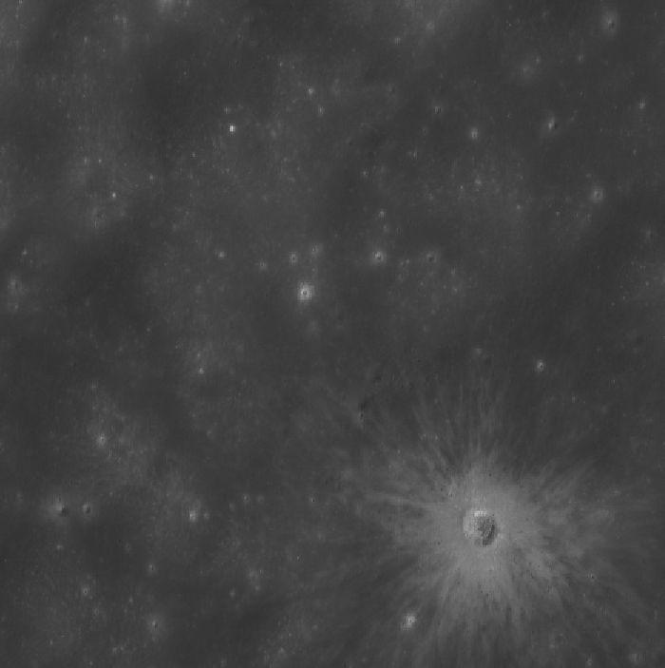
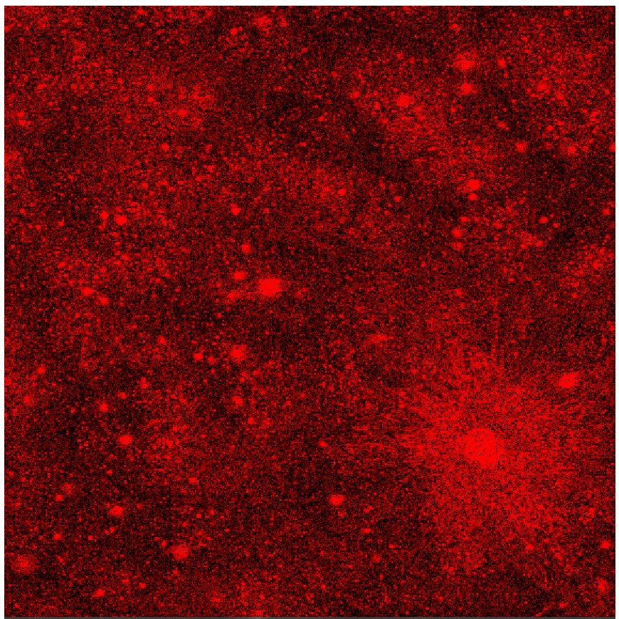
QGIS
Fig: Oth image of the moon
Fig: Generated the slope map of the given Oth with set parameter of slope greater than 10 deg, to be illustrated in red

Slide 25
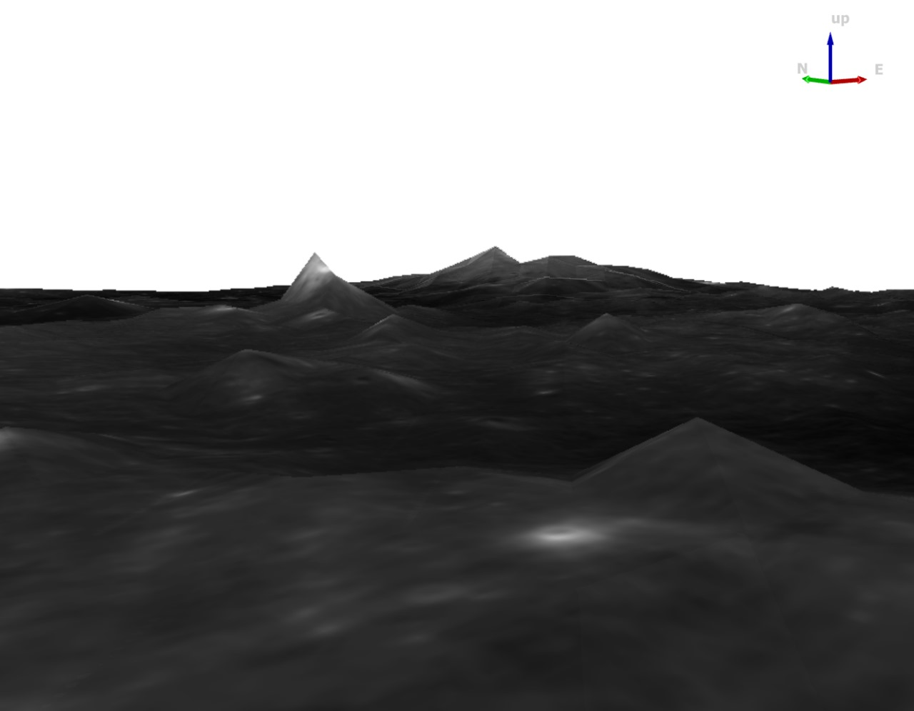
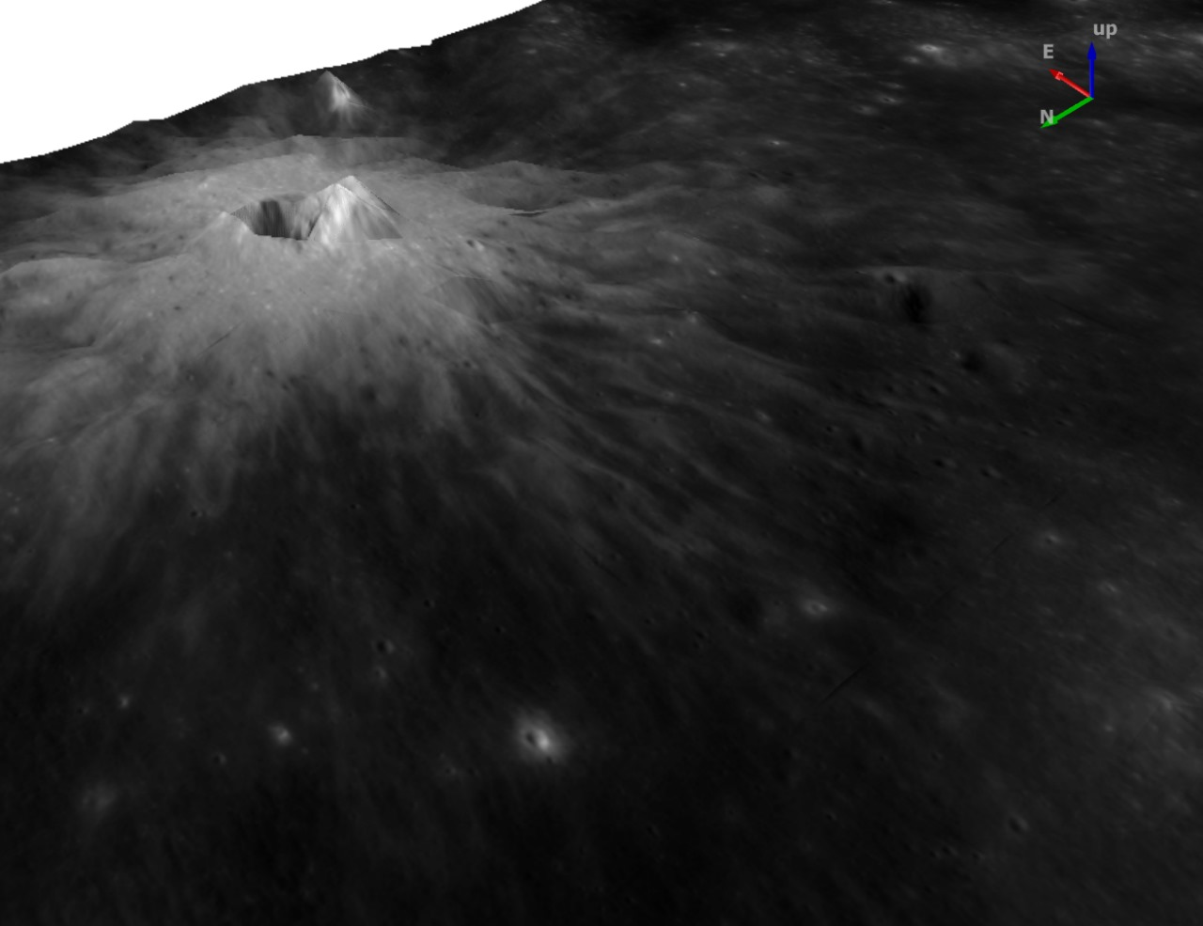
yyyy
QGIS
Fig: A 3-D Surface render made by QGIS of the same scene

Slide 26
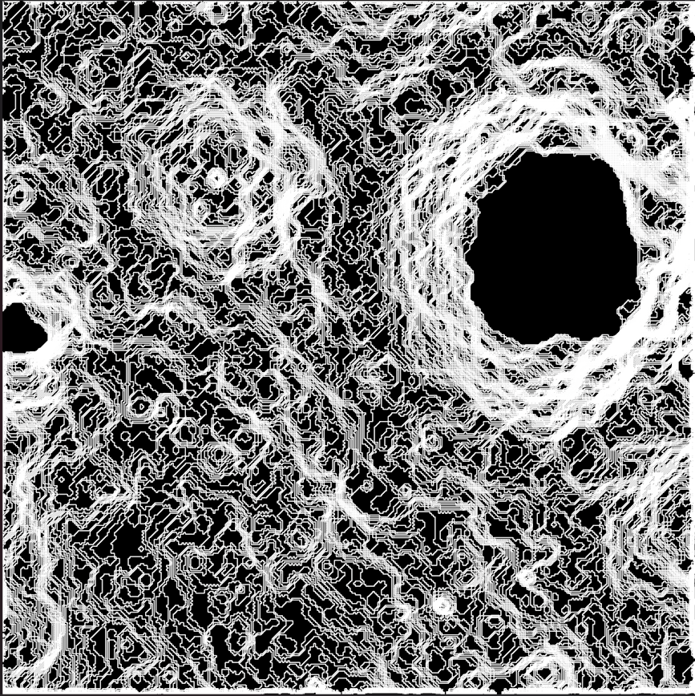
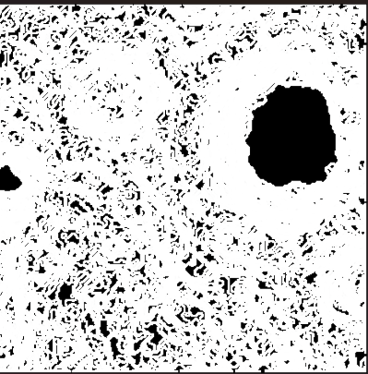
yyyy
Slope Map
Fig: Slope Map of a given DMT
Fig: Slope map of Super Sampled DMT

Slide 27
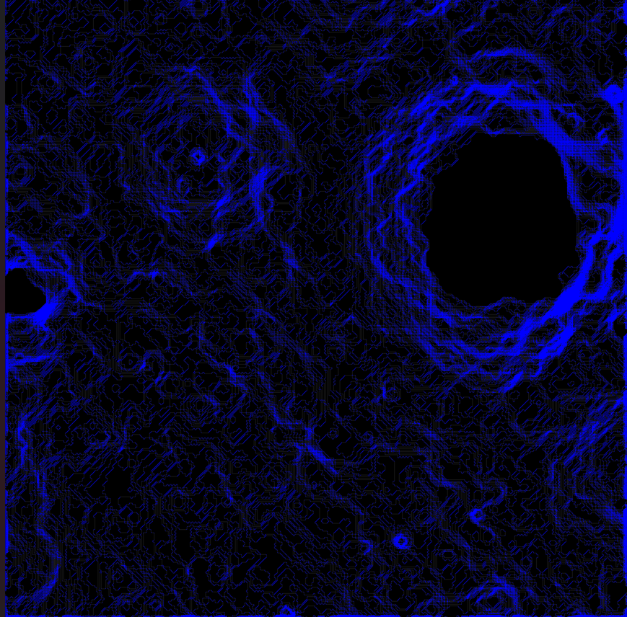
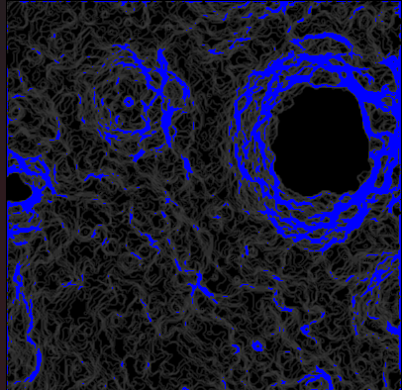
yyyy
Slope Hazard
Fig: Slope Hazard Map (indicates points with slope greater than 10deg)
Fig: Slope Hazard Map for super sampled DMT

Slide 28
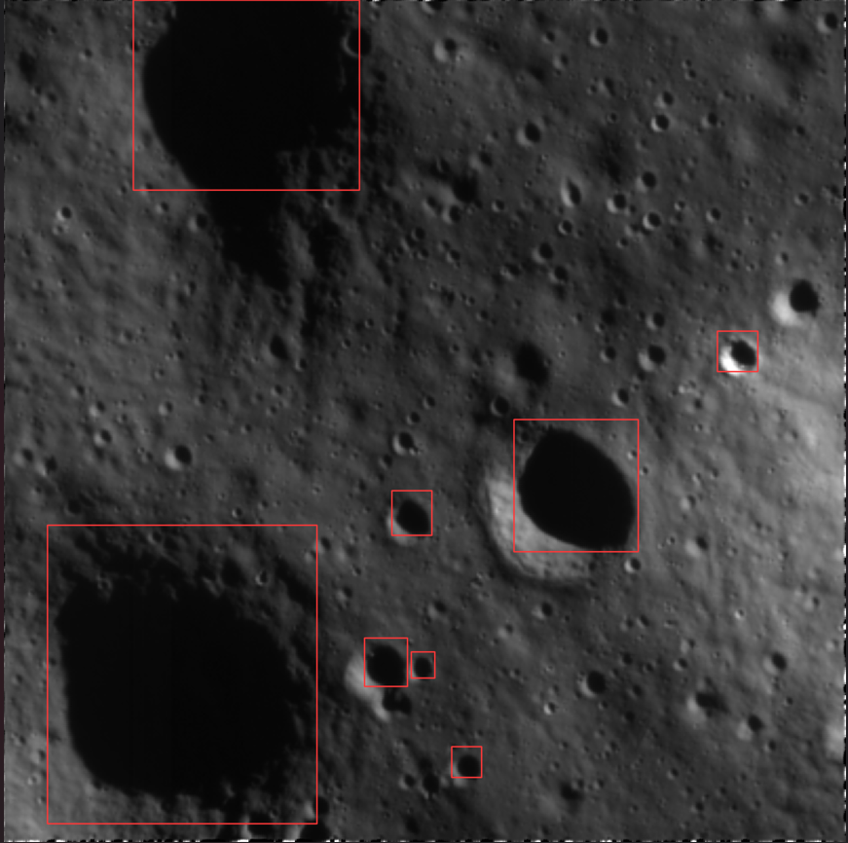
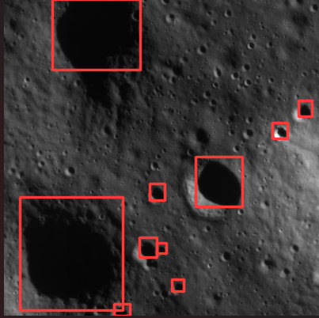
yyyy
Crater Detection
Fig: Crater Detection with Ellipse RCNN model
Fig: Crater detection of Super Samled Image

Slide 29
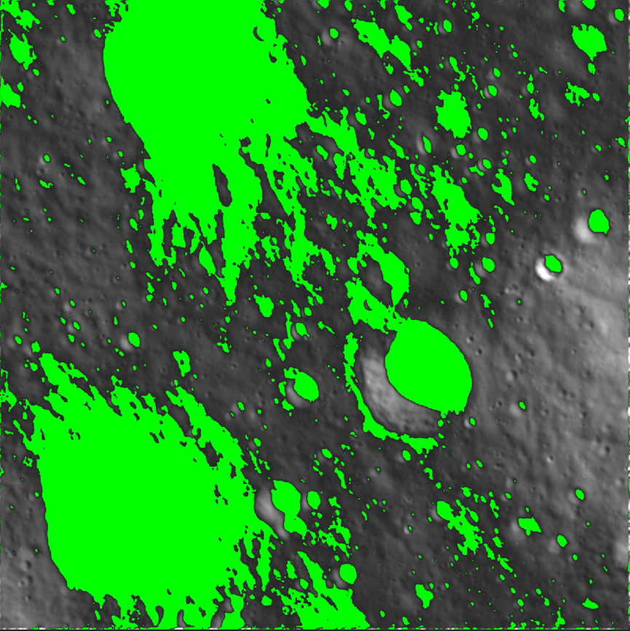
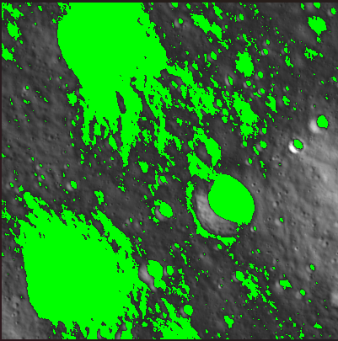
yyyy
Shadow Detection
Fig: Shadow Detection on surface with help of Orthographic images
Fig: Shadow detection on Super Sampled Image

Slide 30
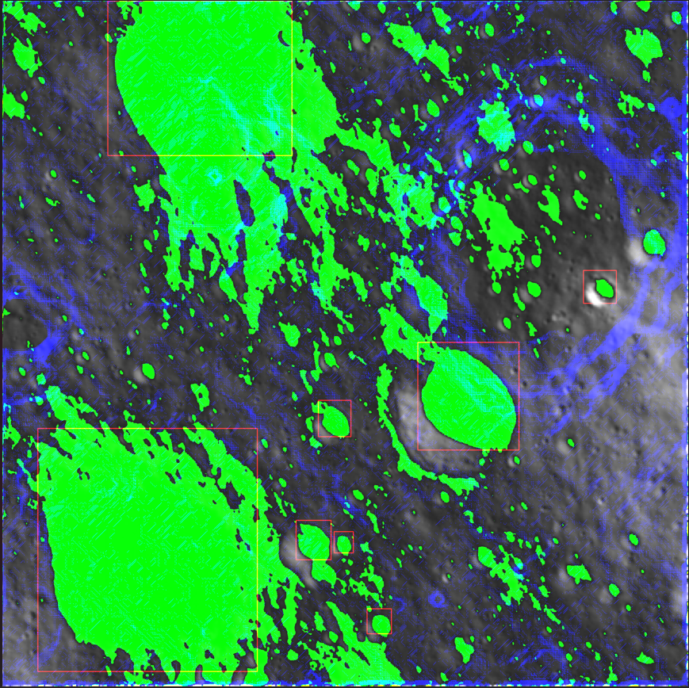
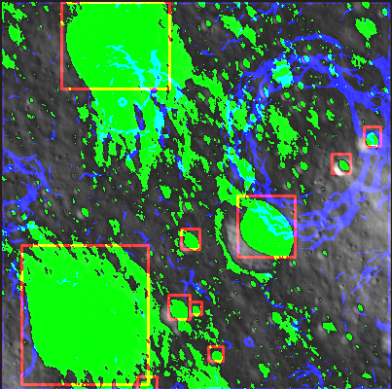
yyyy
Hazard Map Detection
Fig: Hazard Map indicating craters, boulders, shadows and high inclinations
Fig: Hazard map on SuperSampled image

Slide 31
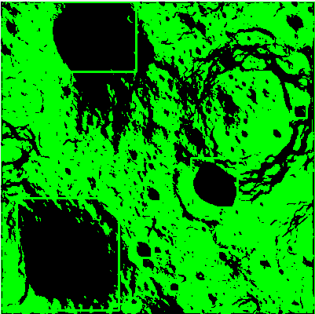
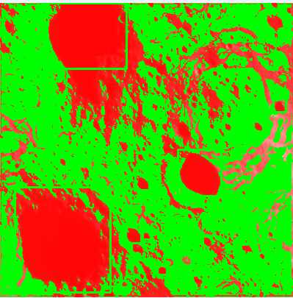
yyyy
Creation of Hazard Map
Fig: Final Hazard Map

Slide 32
Thank You

